Slide 1

Investigating the alcohol inequality paradox:
Findings of a Health Equity Audit in a Local Authority
Dani Plowman, Dr Rich Tyler | 24th March 2023 |
South East Public Health Conference 2023

Slide 2
Overview
Context and aims of the project
Health Equity Audits (HEA)
Methods
Reproducible Analytical Pipelines (RAP)
Findings (related to socioeconomic factors)
Recommendations
Around reducing health inequalities
Around rapidly updating HEAs
Conclusions

Slide 3
Context and aims of the project
Alcohol misuse remains a leading risk factor
for premature mortality, morbidity and disability
Social consequences such as unemployment, crime, and relationship and family issues
Evidence base indicates substantial differences in consumption across different population groups as well as outcomes.
There is also evidence of an ‘Alcohol Harm Paradox’ whereby despite similar or lower average consumption among those in lower socioeconomic groups, those in these groups may experience greater harms (Bellis et al. 2016).
This project aimed to identify inequity of access and outcomes within specific population groups and geographical locations across the whole pathway.

Slide 4
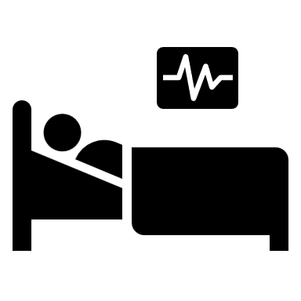




West Sussex in numbers
Based on the age and sex distribution of our local population and the national prevalence estimates…
110,000
people drinking at potentially
hazardous levels
Alcohol Use Disorders Identification Test – AUDIT
A 10 question self-assessment of alcohol consumption
12,000
A further
drinking at harmful/mildly dependent levels.
Score 0–7 = low risk
Score 16–19 = harmful
8,000
drinking to probable dependence levels.
Score 8–15 = hazardous
Score 20-40 = probable dependence
Just one in five estimated dependent drinkers (22%) in specialist alcohol treatment
4,230
Hospital admission episodes due to alcohol-specific conditions
115
alcohol-specific
deaths
each year
including
380
Admissions for alcohol-related
unintentional injuries
and
375
Admissions for intentional self-poisoning by and exposure to alcohol
Notes:
Maybe not here, but we probably want to explain AUDIT scores in relation to measuring. – From the HEA report
Services supporting people with alcohol misuse and surveys exploring this issue typically utilise the AUDIT tool. This is a comprehensive 10 question alcohol harm screening tool, originally developed by the World Health Organisation and modified for use in the UK. Longitudinal surveys exploring prevalence of risky drinking (an AUDIT score of 8 and over) have reported an increased prevalence of risky drinking since the pandemic. Outcomes associated with risky alcohol consumption also may have worsened since the pandemic. For instance, the rate of alcohol specific mortality in England has been stable since 2012, but in 2020 there was a statistically significant increase in the rate of deaths wholly attributable to alcohol in England.
The prevalence of risky drinking and the harms associated with alcohol consumption are not seen evenly across society. The academic literature and national surveys indicate that males and people aged 55-59 are more likely to experience the harms associated with alcohol misuse. Further to this, despite lower average consumption in areas of high deprivation, these groups experience significantly greater harm related to alcohol use compared to the least deprived areas. There is less clear evidence related to alcohol related harms in other groups where health inequalities are often seen, but there is national evidence that some LGBTQ+ communities and some minority ethnic groups may be at disproportionate risk.

Slide 5
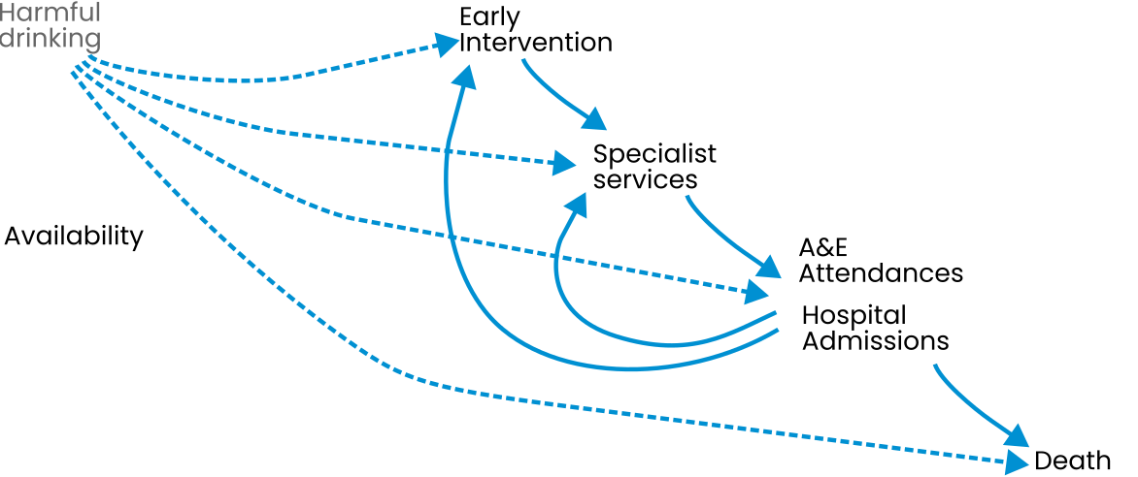
Alcohol harms pathway – observable points
Data out of scope:
Screening and brief interventions in General Practice or Mental Health and hospital settings.
Treatment provided privately.
People seeking support in online and community groups.
Simplified schematic, mostly around the parts of the population/service/outcomes we can actually measure.
Notes:
Based on the age and sex distribution of our local population and the national prevalence estimates, this would indicate that approximately 7,825 people may be dependent drinkers in West Sussex.
I wonder if we put the alcohol pathway here in the context bit in terms of explaining what we’re talking about by access, and then on the next slide outcomes (and introducing AUDIT)
Also thinking we have a figure here with the pathway, and then again on slide 9 with annotations of HEA findings.
Difficult to represent flow though – avoiding the representation that it is always linear, as some may attend services after hospital treatment/episode and also avoid the representation that all harmful/risky consumption leads to treatment/hospital/death.

Slide 6
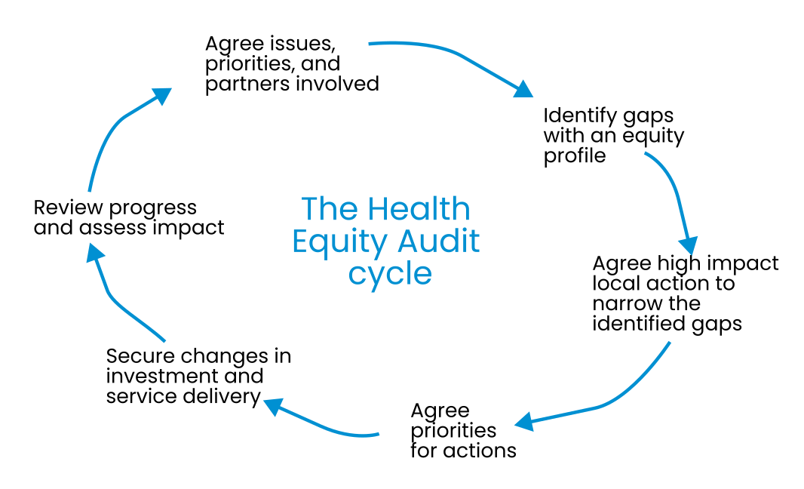
Health Equity Audit
A Health Equity Audit (HEA) is concerned with how fairly resources, opportunities, and access are distributed according to the needs of different groups.
HEAs provide local evidence that can inform action to improve equity of access and outcomes.
This may involve reviewing resource allocation to ensure services offered are proportionate to need across different geographical areas and population groups.
They are intended to be refreshed regularly to assess the impact of actions and can support continuous improvement.
Not a single product/report but a process
The Health Equity Audit cycle (Health Development Agency, 2005)
Reproduced without permission
Notes:
Deliberately removed the numbers

Slide 7
Methods
Estimating need
An eligible population model of alcohol consumption was developed using regional/national prevalence estimates apportioned to local population estimates to determine the number of people drinking at hazardous, harmful, or probable dependent levels.
Quantifying access/outcomes
We analysed anonymised record level data from local alcohol misuse services as well as separately analysing secondary care use related to alcohol from Hospital Episode Statistics (HES) extracts.
We compared these to the eligible population model.
Data for services available for April 2019 to March 2022.
At the time of publication, HES data were unavailable for 2021/22 so we used a three year pooled time period April 2018 to March 2021.
Due to small numbers of people in specific groups it was often necessary to aggregate minority groups (such as amalgamating all sexual orientation minority groups into LGB+), or all ethnic minority groups not White British.
Residential area data is available at output area (LSOA) and we have aggregated to ward to reduce impact of small numbers on identification disclosure but this is using a ‘best-fit’ method.
Completeness of data compounded the problem of small numbers and making conclusions/recommendations.
Things to note:
Notes:
service data was analysed to assess equity of access and outcomes across a range of characteristics, such as age, sex, ethnicity and deprivation status. Where possible, this was compared to the eligible population model to understand whether there were greater or fewer episodes of activity in services in some population groups than we might expect. The main sources of data used here were Public Health commissioned service data, Hospital Episode Statistics and mortality data retrieved from the Office for National Statistics and from Office for Health Improvement and Disparities (OHID) fingertips data.

Slide 8
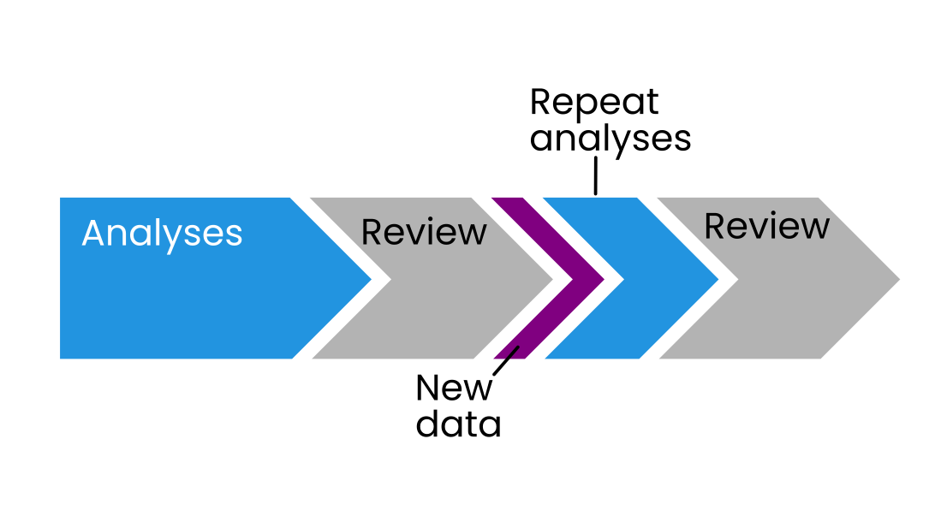

Methods continued
All analyses were conducted using the open source software R
Rather than clicking and dragging and writing excel formula, you write out the processes of the analysis in scripts (like syntax in SPSS).
This enabled a Reproducible Analytical Pathways/Pipelines (RAP) to be established.
Do the work once, write out the steps, then automatically repeat on updated data.
This is particularly useful for HEAs to efficiently incorporate new or changing data in future iterations as part of a rolling programme of work.
Goldacre Review,
April 2022
Adapted from the Government Analysis Function guidance on reproducible analytical pipelines. Reproduced without permission
https://analysisfunction.civilservice.gov.uk/support/reproducible-analytical-pipelines/
Notes:
I think maybe we briefly state it here about R – and RAPs, then move to the results, and then in the conclusions we talk about how useful R is (and is going to be) for rerunning parts of the analyses/outputs if/when new data arrive, or we explore impact of any interventions/changes in data collection.
Modern, open working methods for NHS data
7. Promote and resource ‘Reproducible Analytical Pathways’ (RAP, a set of best practices and training created in ONS) as the minimum standard for academic and NHS data analysis: this will produce high quality, shared, reviewable, re-usable, well-documented code for data curation and analysis; minimise inefficient duplication; avoid unverifiable ‘black box’ analyses; and make each new analysis faster.

Slide 9
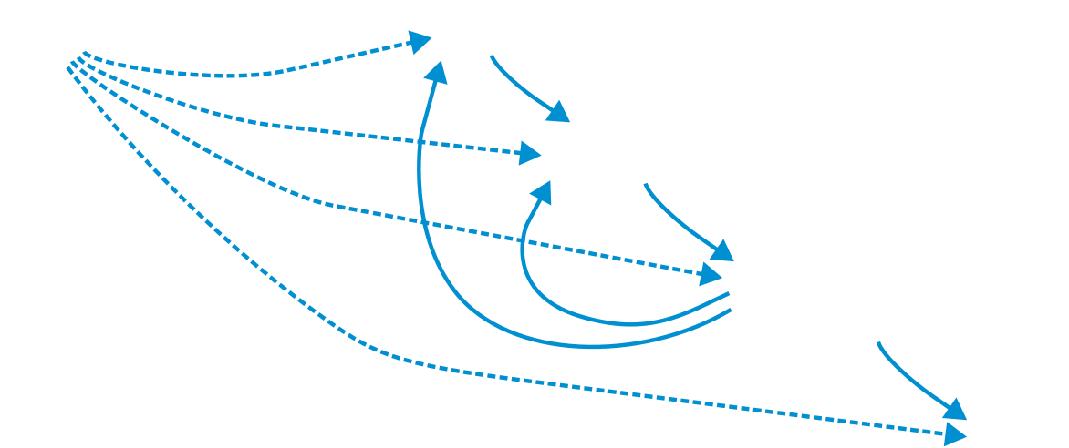
Findings (selected focus on socioeconomic factors)
Early
intervention
Second highest group accessing the early intervention service were those who were unemployed after managerial and professional groups.
Alcohol
consumption
Data on deprivation not routinely collected in local services
National data
indicates lower
consumption overall
in less deprived areas.
However, adults in least deprived areas more likely to drink at risky levels.
Specialist
services
Steep social gradient in caseload. Indication of poorer outcomes in those in the most deprived areas but not statistically significant difference.
Alcohol
related A&E
attendances
and hospital
admissions
Higher proportion of residents in most deprived areas with five or more attendances over the study period than those in least deprived neighbourhoods
One in three in most deprived areas were ‘non-drinkers’ compared to one in ten in least deprived areas.
Greater number of admissions in more deprived deciles (deciles 2-4) than less deprived areas (deciles 6-9) but no clear gradient. Cause of admission varied by deprivation decile
Alcohol availability
If were including this we could add some brief line around density of outlets and admissions.
Alcohol specific mortality
Small numbers in local data.
Nationally there is a significantly higher alcohol specific rate of death in most deprived compared to least deprived neighbourhoods.
Notes:
One service with employment as a proxy suggests that the second highest group accessing the service were those who were unemployed (after managerial and professional groups).
The proportion of adults who were non-drinkers was highest in most deprived areas (29%) compared with 10% in the least deprived areas.
Adults in least deprived areas were more likely to drink over 14 units in a usual week (27%) than those in most deprived areas (18%). 36% of men in the least deprived areas drank at increasing and higher risk levels, compared with 27% of men in the most deprived areas. 17% of women in the least deprived areas drank more than 14 units compared with 10% of women in the most deprived areas.
The variation in weekly alcohol consumption by deprivation was accounted for by differences in the proportions of men and women drinking at increasing levels of risk (that is, over 14 units and up to 50 units for men and over 14 units and up to 35 units for women) rather than the smaller proportions in the higher risk category (over 50 units for men and over 35 units for women). The proportion of men and women drinking at higher levels of risk was similar by IMD quintile.
ONS alcohol specific age-standardised rates based on 2020 registration suggest:
Three times the risk in females in most deprived compared to females in least deprived
-Four times the risk in males in most deprived compared to males in the least deprived.
Alcohol-specific deaths in the UK: liver diseases and the impact of deprivation - Office for National Statistics (ons.gov.uk)

Slide 10

Findings continued.
Service providers and commissioners were supportive of the process throughout the project.
However, we required more granular data than routine reporting, and agreeing access was a time consuming process for some providers due to data protection concerns.
In one case we were unable to obtain anonymised record level data, which limited our analyses.
Some key characteristics were not collected by all providers (e.g. deprivation, ethnicity).
For some characteristics there were significant numbers of records where data was incomplete (e.g. disability, sexual orientation).

Slide 11

Recommendations around reducing health inequalities
Commissioners and providers consider additional approaches to reach groups that access services less than we expect given estimated service need.
Review the framework for triaging and assessing licence applications to take into account areas of high alcohol related admissions and service use.
Commissioners to include increased data requirements within contracts for characteristics associated with known inequalities.
Commissioners and leads to review inequalities data as part of regular contract monitoring to enable earlier identification of inequities in access/outcomes and more iterative action.
Consider approaches to addressing concerns of providers for collecting or sharing data relating to specific characteristics, including data sharing agreements, training, memorandum of understanding around communicating results/sharing information.
Establish the HEA as part of a rolling programme of work (rather than a one off report) to address inequalities together at pace.

Slide 12
Recommendations around rapidly updating HEAs
HEAs are large pieces of work, requiring a lot of administrative and analytical resource with multiple data sets/sources that change over time with new data becoming available (from services as well as new information about consumption)
This can be difficult to prioritise in work plans.
This project demonstrates opportunities to:
Standardise HEA processes using Reproducible Analytical Pipelines where new data can be fed into existing workflows.
Automate analysis steps as well as visualising outputs and generating reports.
Allowing for scrutiny of methods even after a report is published.
Notes:
Refresh might include regular ones planned eg every two years but also when new data comes to light, eg census
Modern, open working methods for NHS data
7. Promote and resource ‘Reproducible Analytical Pathways’ (RAP, a set of best practices and training created in ONS) as the minimum standard for academic and NHS data analysis: this will produce high quality, shared, reviewable, re-usable, well-documented code for data curation and analysis; minimise inefficient duplication; avoid unverifiable ‘black box’ analyses; and make each new analysis faster.

Slide 13
Conclusions
This HEA identified inequities in access and outcomes between groups, including those from lower socioeconomic groups, although there were gaps in the data.
Reducing health inequalities remains a priority locally, regionally and nationally.
HEAs represent an important method of examining inequalities across a broad topic and providing a baseline to measure future actions to reduce inequalities in outcomes.
These are more than a single document; HEAs are evolving processes.
In order to conduct useful HEAs we need to have access to good data and to resources to keep monitoring new information as it arises.
Bringing data together from several sources to identify estimated need and service use/outcomes and preparing the data for analysis can be a complex and technical task.
There are opportunities to reduce the workload associated with conducting and refreshing parts of the HEA through the use of RAPs using open source software such as R.

